Slide 1
Machine Learning
Introduction

Slide 2
Definition of Machine learning
ML is field of computer science/AI that uses statistics techniques to give computer/machine/system the ability to “learn” with data without being explicitly programmed. —Arthur Samuel, 1959
A computer program is said to learn from experience E with respect to some task T and some performance measure P, if its performance on T, as measured by P, improves with experience E. —Tom Mitchell, 1997

Slide 3
Example
your spam filter is a Machine Learning program that can learn to flag spam given examples of spam emails (e.g., flagged by users) and examples of regular (nonspam, also called “ham”) emails.
The examples that the system uses to learn are called the training set. Each training example is called a training instance (or sample).
In this case, the task T is to flag spam for new emails,
The experience E is the training data, and the performance measure P needs to be defined; for example, you can use the ratio of correctly classified emails.
This particular performance measure is called accuracy and it is often used in classification tasks.

Slide 4
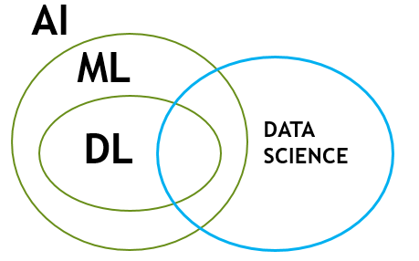
AI : Where AI is system or machine that THINK as well as ACT like human and rationally

Slide 5
AI
RULE BASED
ML/STAS BASED

Slide 6
ANALYTICS
DESCRIPTIVE
PRESCRIPTIVE
WHAT SHOULD WE DO
WHAT IS LIKELY TO HAPPEN
PREDICTIVE
DIAGNOSTIC
WHAT HAPPENED
WHY DID IT HAPPEN

Slide 7
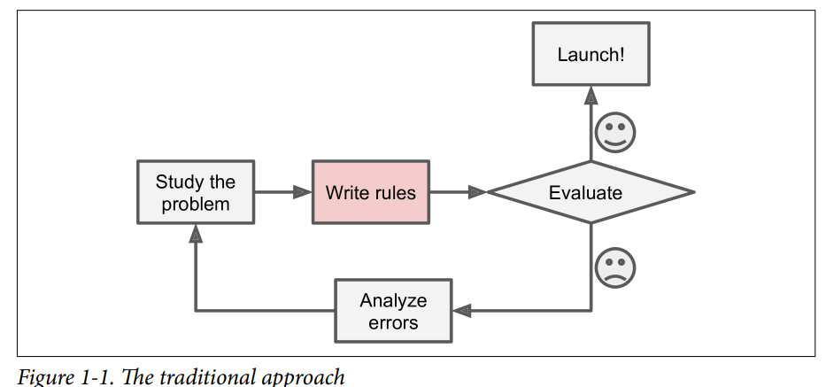
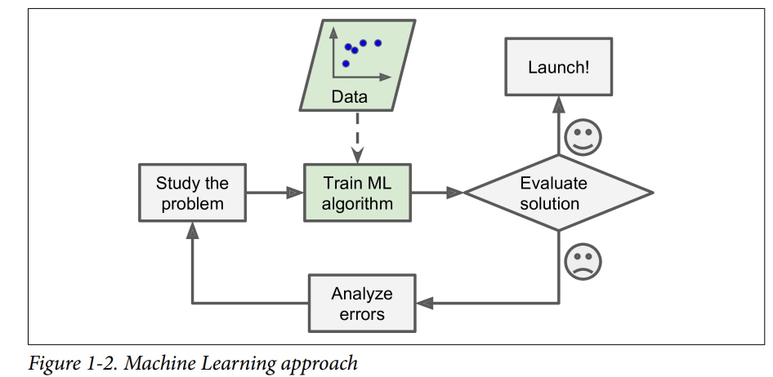
Why Use Machine Learning?
Machine Learning is great for:
Problems for which existing solutions require a lot of hand-tuning or long lists of rules: one Machine Learning algorithm can often simplify code and perform better.
Complex problems for which there is no good solution at all using a traditional approach: the best Machine Learning techniques can find a solution.
Fluctuating environments: a Machine Learning system can adapt to new data.
Getting insights about complex problems and large amounts of data.

Slide 8
ML
SUPERVISED
REGRESSION
CLASSIFICATION
UNSUPERVISED
CLUSTERING
RECONMENDATION
SYSTEM
ASSOCIATION RULE MINING

Slide 9
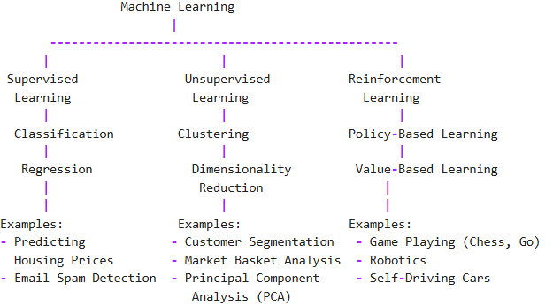
Classification of Machine Learning

Slide 10
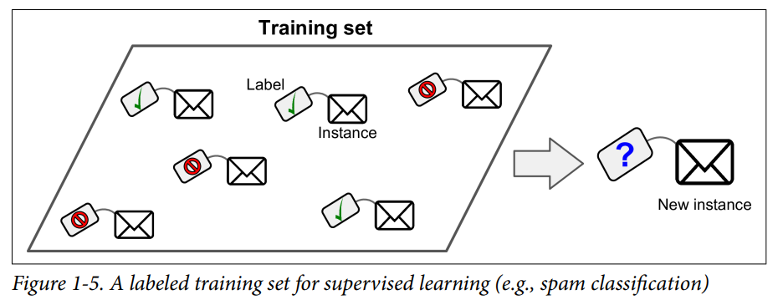
Supervised learning
In supervised learning, the training data you feed to the algorithm includes the desired solutions, called labels

Slide 11
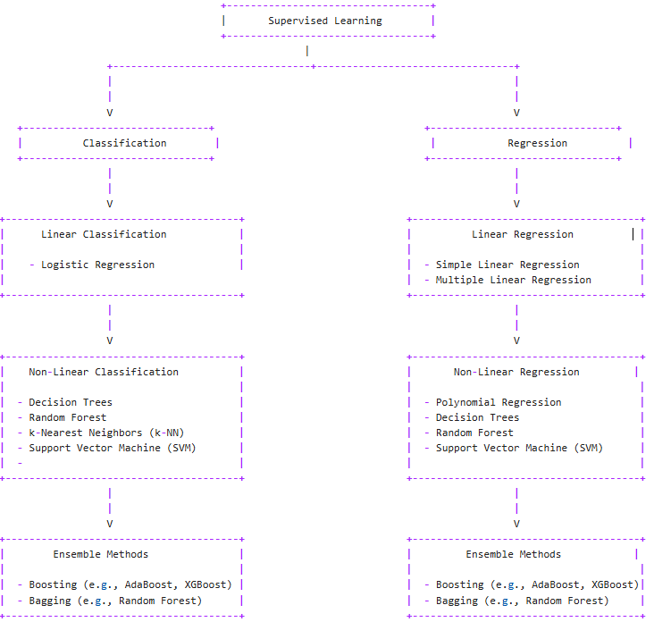
Supervised MACHINE LEARNING

Slide 12
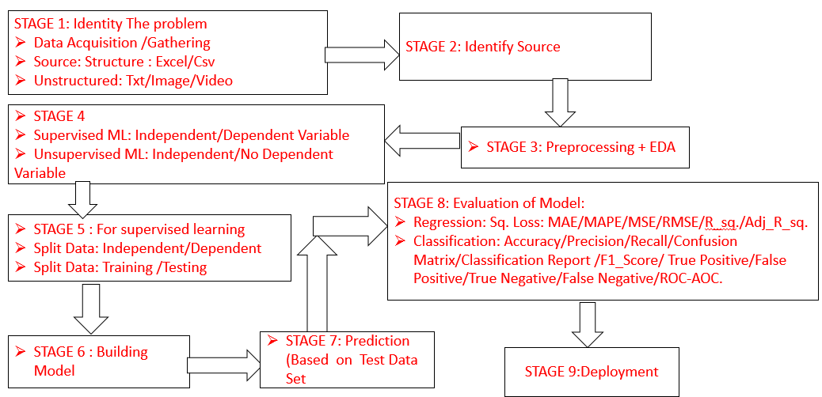

Slide 13
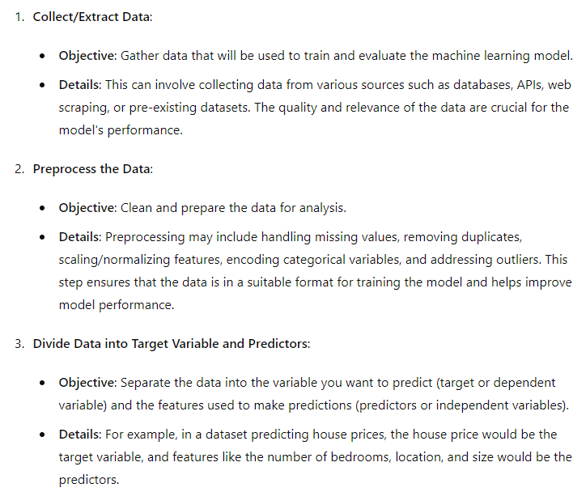
Life Cycle of Supervised Machine Learning:

Slide 14
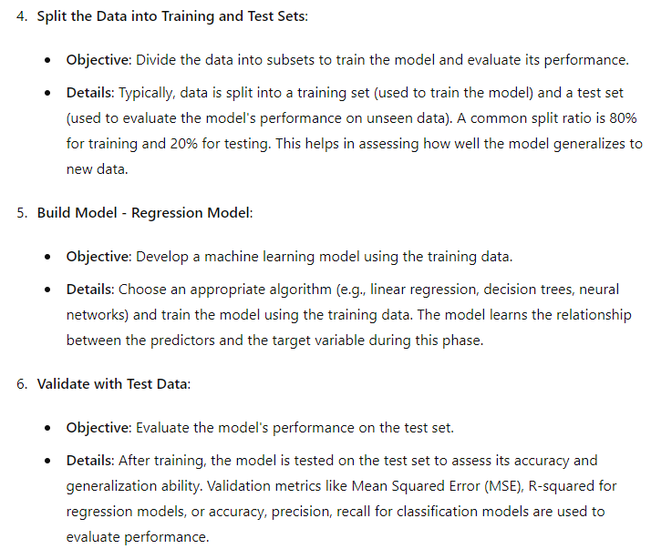

Slide 15
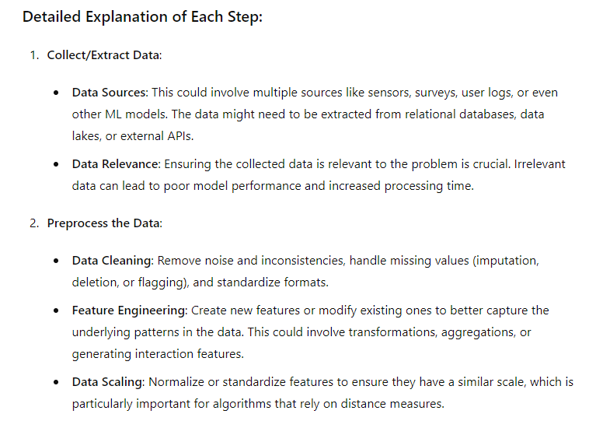

Slide 16
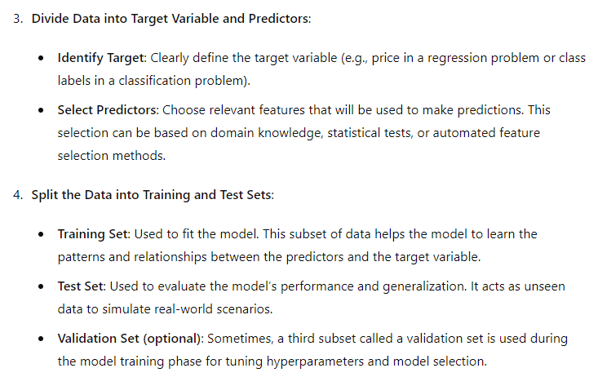

Slide 17
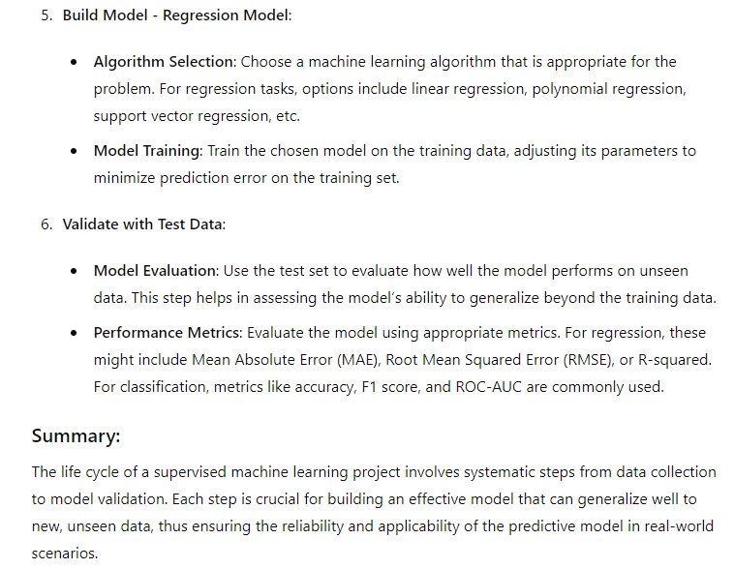

Slide 18
BASIC MATHS
LINEAR ALGEBRA
DESCRIPTIVE
INFERENTIAL
DISTRIBUTION
PERMUTATION
COMBINATION
STATISTICS
PROBABILITY

Slide 19
DATA PREPROCESSING
HANDLING MISSING VALUE
OUTLIER TREATMENT
ENCODING
FEATURE SCALING
IMBALANCE TREATMENT
ONLY FOR CLASSIFICATION
LABEL ENCODER
ONE HOT ENCODER

Slide 20
PROJECT LIFE CYCLE :DATA SCIENCE
STAGE 1: Identity The problem
Data Acquisition /Gathering
Source: Structure : Excel/Csv
Unstructured: Txt/Image/Video
STAGE 2: Identify Source
STAGE 4
Supervised ML: Independent/Dependent Variable
Unsupervised ML: Independent/No Dependent Variable
STAGE 3: Preprocessing + EDA
STAGE 8: Evaluation of Model:
Regression: Sq. Loss: MAE/MAPE/MSE/RMSE/Rsq./Adj_Rsq.
Classification: Accuracy/Precision/Recall/Sensitivity/Specificity/Confusion Matrix/Classification Report /F1_Score/ True Positive/False Positive/True Negative/False Negative/ROC-AOC.
STAGE 5 : For supervised learning
Split Data: Independent/Dependent
Split Data: Training /Testing
STAGE 6 : Building Model
STAGE 7: Prediction (Based on Test Data Set
STAGE 9:Deployment

Slide 21
Course: Stats and ML(80 hrs)
Class | Topic | SubTopic
1 | Stats(8 hrs) | Measure of central tendency Measure of Spread Covarience/Correlation Hypothesis testing /Chi square Z test/ ANOVA
 |  | Permutation combination (4hrs) Distribution: Normal/Binomial/Poisson
2 | Data Preprocessing(6 hrs) | Handling missing value Handling outliers Handling data types Encoding Feature Scaling Balancing of data EDA
3 | Supervised Machine Learning | Regression (6 hrs)
 |  | Logistics Regression(6hrs)
 |  | Decision Tree (6 hrs)
 |  | Ensemble (8 hrs) Bagging /Random Forest Boosting/Ada/Gradient/XG Bias Variance Trade off
 |  | Probability /Naïve Bayes (6 hrs)
 |  | Linear Alzebra (2 hrs) ,K Means(4hrs)
 |  | SVM (4 hrs)
4 | Unsupervised Machine Learning | Clustering(4 hrs)
 |  | DBSCAN( 4 hrs)
 |  | Recomendation System(4 hrs)
 |  | PCA( 2 hrs)
 |  | Transformer Binning(2 hrs)
 |  | Project(4 hrs)

